Slide 1
Build apps with the Microsoft Graph REST API
Build a ASP.NET web application using Microsoft Graph

Slide 2

Incorporate the Microsoft Graph into a web application
Leverage OWIN & MSAL middleware to handle authentication
Use native .NET HTTP APIs to issue HTTP requests to the REST API
Consider JSON.NET for dealing with OData JSON responses

Slide 3
Creating an ASP.NET web application configured with MSAL & OWIN middleware for authentication with Azure AD

Slide 4
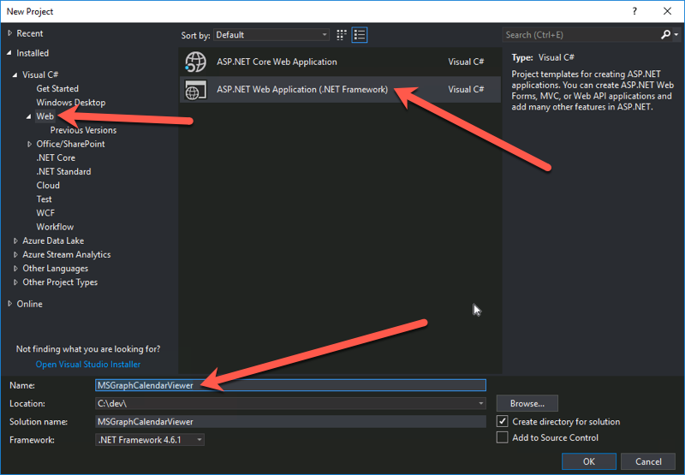
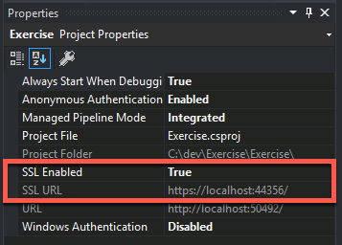
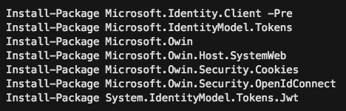
Create ASP.NET MVC Web Application
Create the ASP.NET MVC web application
Do not use the Visual Studio wizard to configure authentication
Configure it to use SSL
The redirect URL must be HTTPS to work with Azure AD applications
Configure it for MSAL & OWIN middleware
This involves installing a few NuGet packages and modifying the project code.

Slide 5
Install NuGet Packages
Microsoft’s Authentication Library (MSAL) & OWIN middleware is distributed using pacakges
The following NuGet packages include MSAL, OWIN middleware and dependent packages:
Install-Package Microsoft.Identity.Client -Pre
Install-Package Microsoft.IdentityModel.Tokens
Install-Package Microsoft.Owin
Install-Package Microsoft.Owin.Host.SystemWeb
Install-Package Microsoft.Owin.Security.Cookies
Install-Package Microsoft.Owin.Security.OpenIdConnect
Install-Package System.IdentityModel.Tokens.Jwt
Notes:
At the time of this writing, the Microsoft.Identity.Client package is pre-release, make sure to include pre-release packages either using the checkbox in the GUI or including the –pre switch on the command line during preview.
Once the production bits are released, make sure to use the production version.

Slide 6
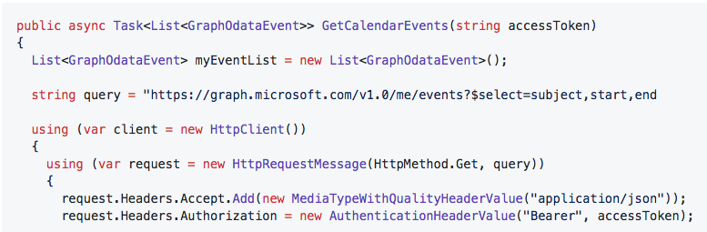
Call the Microsoft Graph REST API from ASP.NET
Use native .NET HTTP APIs to call the Microsoft Graph REST API
Modify the request to include the Authorization header value

Slide 7
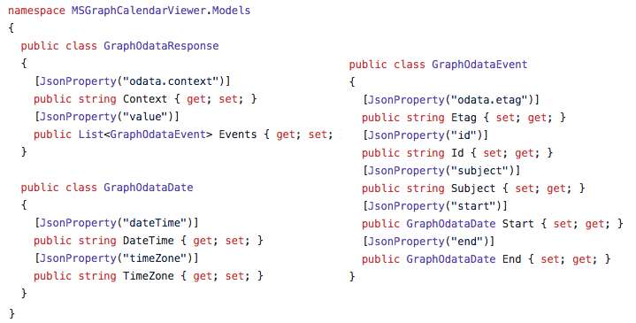
Leverage JSON.NET to Deserialize the OData response from the REST API

Slide 8
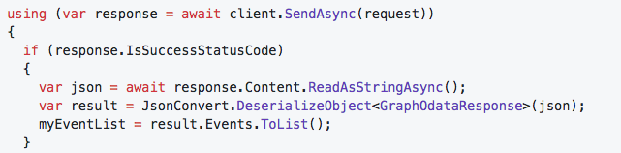
Leverage JSON.NET to Deserialize the OData response from the REST API

Slide 9
Demo

Slide 10
Thank you.

